Slide 1

Community Standards for Next-Generation Modeling
The Open Modeling Foundation (OMF): an international alliance of modeling organizations to coordinate and administer community standards and best practices for computational modeling in the social, ecological, environmental, and geophysical sciences
Series of strategic planning workshops 2019-2021
67 organizations representing modeling science and stakeholders participated
Formally adopted governing charter and values statement December 2021

Slide 2

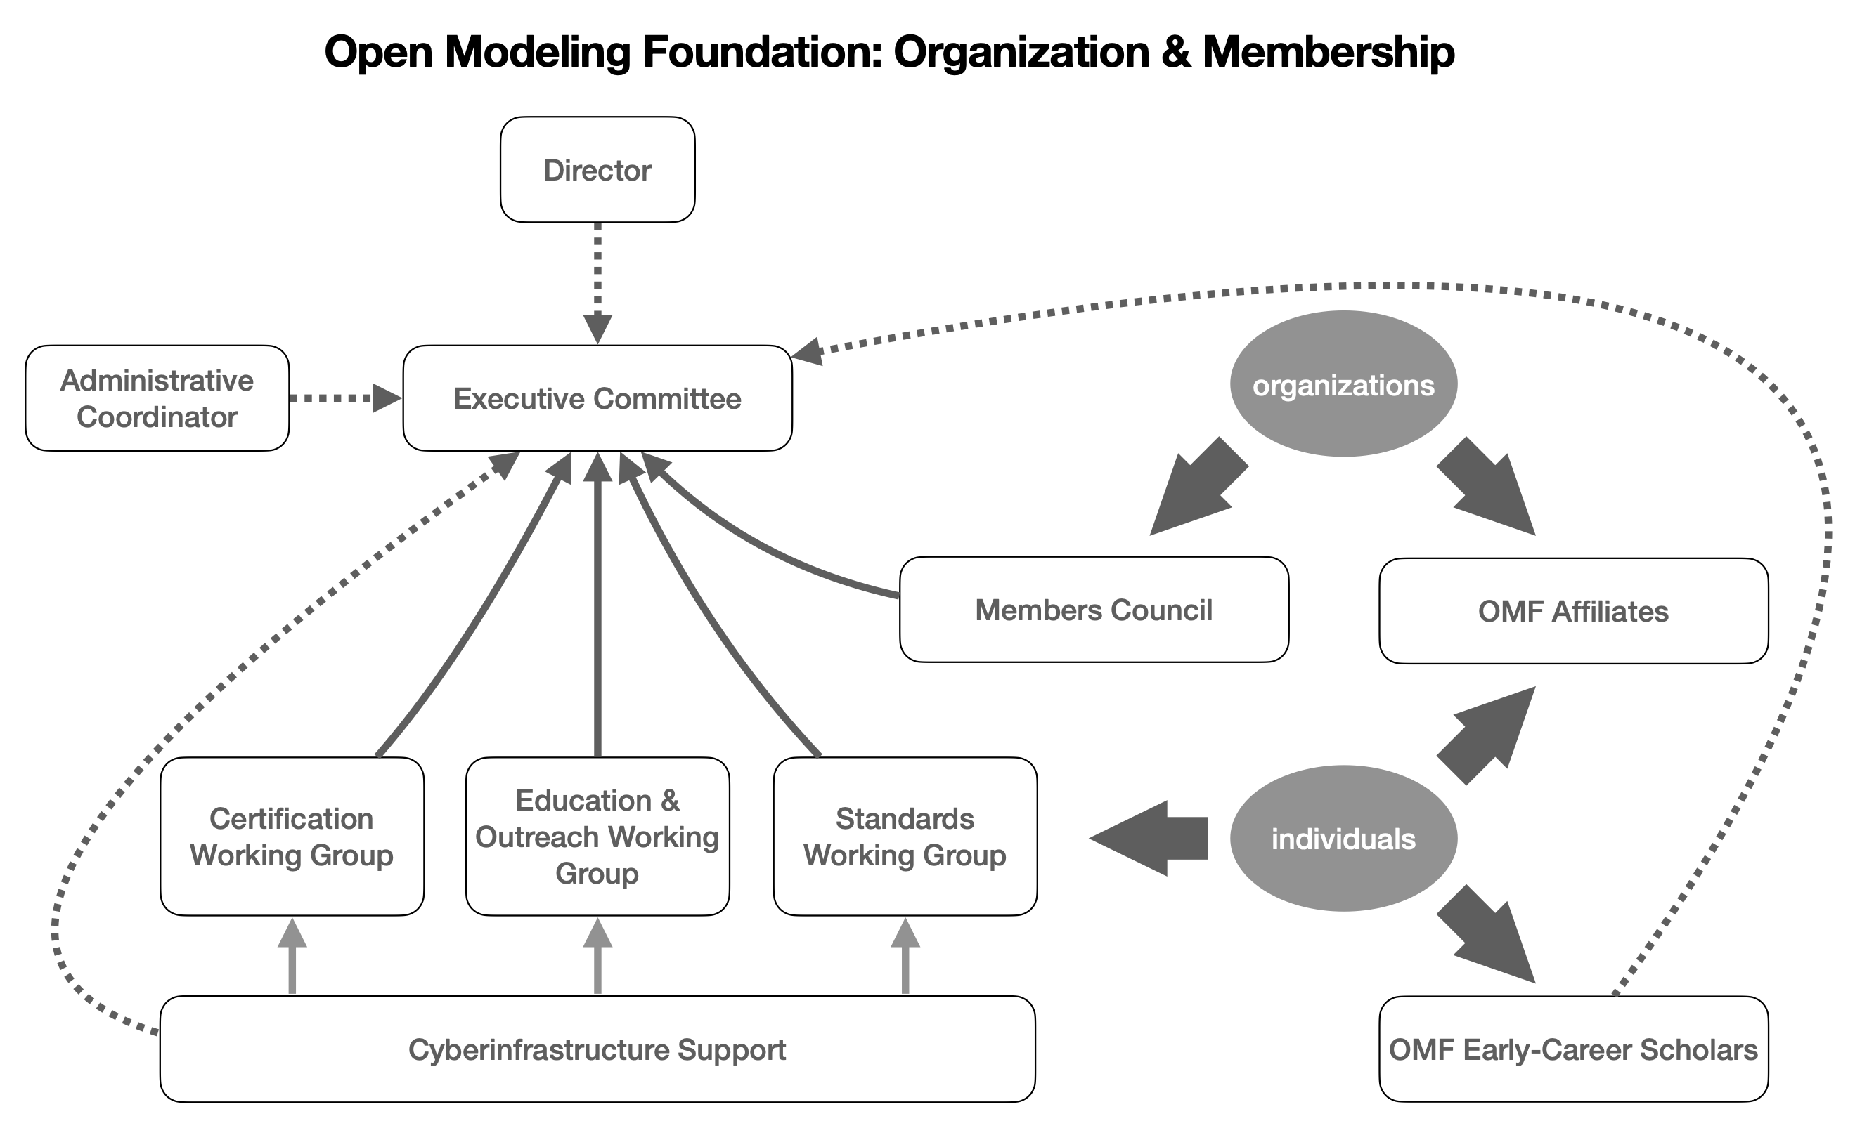
Community Standards for Next-Generation Modeling
Current status
47 member organizations
Representing >10,000 modeling scientists from around the world
Elected International Excutive Committee
Now organizing working groups: membership open
Supported by the

Slide 3
Community Standards for Next-Generation Modeling
The Open Modeling Foundation (OMF) is an international open science community that works to enable the next generation modeling of human and natural systems. The Open Modeling Foundation is an alliance of modeling organizations that coordinates and administers a common, community developed body of standards and best practices among diverse communities of modeling scientists. It also provides informational, data, and technological resources to facilitate the implementation of common standards and best practices among the scientific communities it serves.
The OMF endeavors to accelerate modeling science by making models more easily discoverable and globally accessible. It also develops and administers a suite of common standards and technology for model reusability, reproducibility, and interoperability.The OMF also promotes the recognition of those who endeavor to apply these standards and best practices through the ethical practice of fully citing models and model authors, whenever their work is used by others.
From OMF Charter: https://openmodelingfoundation.github.io/governance/charter/

Slide 4
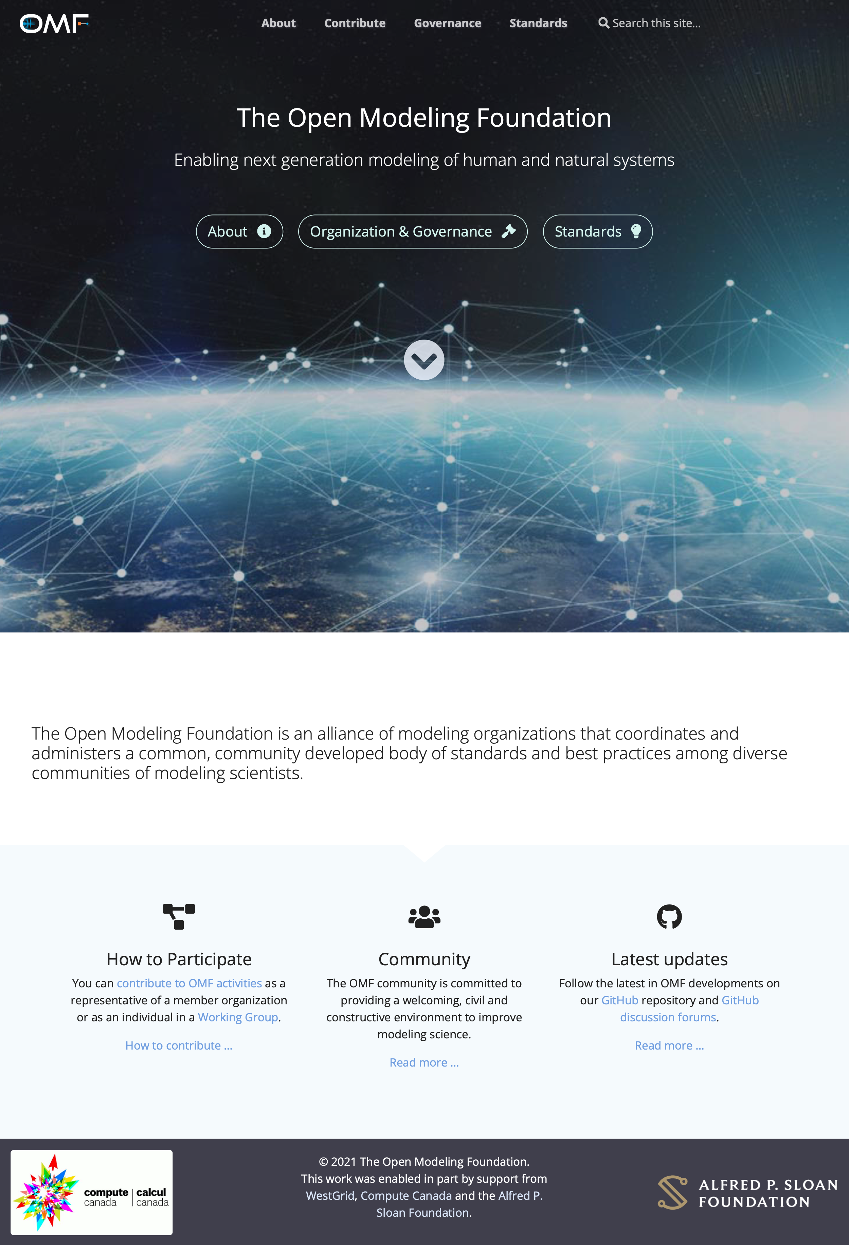
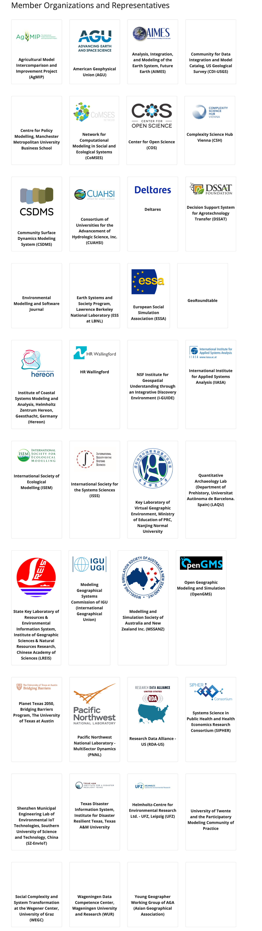
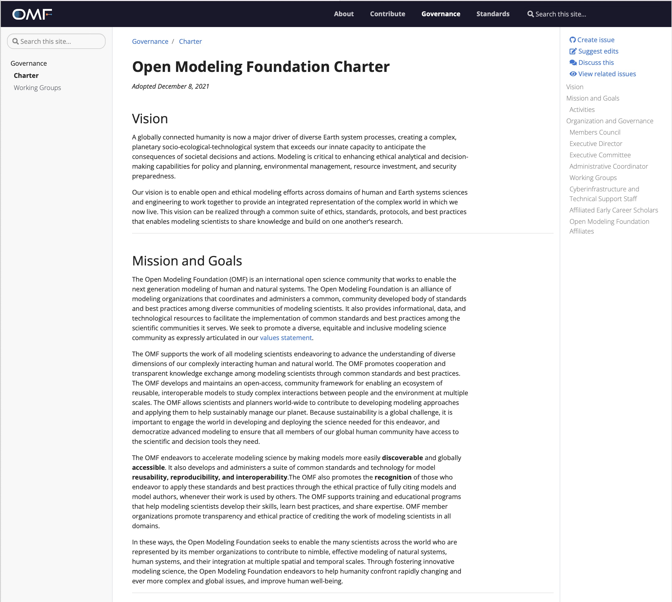
Community Standards for Next-Generation Modeling

